Slide 1
Tao Calligraphy Tracing Improves Pain Scores
measured by the McGill Pain Questionnaire
(SF-MPQ) in 3 months
Consuelo Fernandez, MD; Amy Yamashiro, EdD
Society for Integrative Oncology 18th International Conference:
"The Science of Living Well with Cancer" September 24-26, 2021, Baltimore, Maryland
Notes:
9/26/2021
1
1

Slide 2
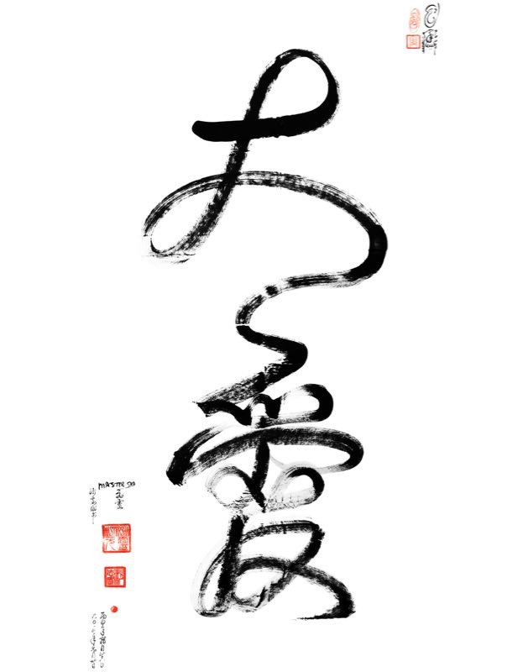
Tao Calligraphy Tracing Improves Pain Scores measured by the McGill Pain Questionnaire (SF-MPQ) in 3 months Society for Integrative Oncology 18th International Conference: "The Science of Living Well with Cancer" September 24-26, 2021, Baltimore, Maryland Consuelo Fernandez, MD; Amy Yamashiro, EdD
Background
Methods & Design
Conclusion
Researchers have previously found that movement meditation which combines Tao calligraphy tracing and mantra chanting improves the quality of life. These researchers have also confirmed the efficacy of transmission and Tao calligraphy tracing combined with conventional medical treatment. This research study investigated the effects of Tao calligraphy tracing with mantra chanting on patients with chronic pain treated at a private pain management practice in Maryland, and was conducted in collaboration with the Sha Research Foundation.
An IRB approved prospective analysis study investigated the effects of combining a transmission (power to meditate) with Tao calligraphy tracing and mantra chanting on short-form McGill Pain Scores. Initially 51 patients suffering from chronic pain were enrolled, after 3 months, 45 remained: 25 males, 20 females, with an average age of 47.2 (27-72) years. All patients continued with their conventional treatment protocols throughout the study, they received a transmission and were instructed to trace Tao calligraphy with fingers while chanting a mantra for 30 minutes a day. The short-form McGill Pain questionnaire (SF-MPQ) was filled out at the start of the study and again after three months.
Results indicate that movement meditation combining Tao calligraphy tracing and mantra chanting improves the overall pain intensity and fearful quality of pain for participants as measured by the SF-MPQ scale, even with sub-optimal compliance of subjects to trace (only 8 minutes of practice a day in average was reported). Tracing Tao calligraphy and mantra chanting were easy to learn, well tolerated and no complications arose.
References
1. Baer R.: Mindfulness training as a clinical intervention: A conceptual and empirical review. Clinical Psychology: Science and Practice. 2003;10:125–143.
2. Kabat-Zinn J. Mindfulness-based interventions in context: Past, present, and future. Clinical Psychology: Science and Practice. 2003;10:144–156.
3. Kuan-Yu, Chih-Yang Huang, Wen-Chen Ouyang: Does Chinese calligraphy therapy reduce neuropsychiatric symptoms: a systematic review and meta-analysis. BMC Psychiatry, 2018; 18:62.
Results
An Anova Test was used to analyze the results. There was a statistically significant improvement of overall pain intensity (PPI) for patients with chronic pain (F = 14.209 P= 0.000); and in fearful category of pain (F = 4.268 P= 0.042). The other categories of pain were not changed significantly.
Contact
Website: www.sharesearchfoundation.com
Email: sharesearchfoundation@yahoo.ca
Tel 1-604-436-3313

Slide 3
Background
The last two decades have seen the development of mindfulness (heightened awareness) based interventions in health.
The empirical literature on the effects of mindfulness training suggests that mindfulness interventions may lead to reductions in a variety of conditions, including pain.
Mindfulness or heightened awareness can be easily achieved by tracing Tao Calligraphy and chanting a mantra.
Notes:
9/26/2021
3
3

Slide 4
What is Tao Calligraphy?
Tao Calligraphy is a one stroke calligraphy which connects the patient or practitioner with a very high frequency and vibration creating a positive light field.
Notes:
9/26/2021
4
4

Slide 5
Tao Calligraphy Research
Researchers have previously found that movement meditation which combines Tao calligraphy tracing and mantra chanting improves the quality of life.
These researchers have also confirmed the efficacy of combining Tao calligraphy tracing with conventional medical treatment.
This research study investigated the effects of Tao calligraphy tracing with mantra chanting on patients with chronic pain
Notes:
9/26/2021
5
5

Slide 6
Methods and Design
An IRB approved prospective analysis study investigated the effects of combining a transmission (power to meditate) with Tao calligraphy tracing and mantra chanting on short-form McGill Pain Scores.
Initially 51 patients suffering from chronic pain were enrolled, after 3 months, 45 remained: 25 males, 20 females, with an average age of 47.2 (27-72) years.
All patients continued with their conventional treatment protocols throughout the study.
The patients received a transmission and were instructed to trace Tao calligraphy with their fingers while chanting a mantra for 30 minutes a day.
The short-form McGill Pain questionnaire (SF-MPQ) was filled out at the start of the study and again after three months.
Notes:
9/26/2021
6
6

Slide 7
Results
An Anova Test was used to analyze the results.
There was a statistically significant improvement of overall pain intensity (PPI) for patients with chronic pain (F = 14.209 P= 0.000); and in fearful category of pain (F = 4.268 P= 0.042). The other categories of pain were not changed significantly.
Notes:
9/26/2021
7
7

Slide 8
Conclusions
Results indicate that movement meditation combining Tao calligraphy tracing and mantra chanting improves the overall pain intensity and fearful quality of pain for participants as measured by the SF-MPQ scale, even with sub-optimal compliance of the subjects to trace the calligraphy (only 8 minutes of practice a day in average was reported).
Tracing Tao calligraphy and mantra chanting were easy to learn, well tolerated and no complications arose.
Notes:
9/26/2021
8
8

Slide 9
Acknowledgements
This presentation was sponsored by the Sha Research Foundation, San Francisco, California
Contact
Website: www.sharesearchfoundation.com
Email: Sharesearchfoundation@yahoo.ca
Notes:
9/26/2021
9
9

